Slide 1
Healthy Churches discern Truth from error
1 Timothy 4:1-16
Preached by Dr. Jim Harmeling at Crossroads International Church Singapore • cicfamily.com Uploaded by Dr. Rick Griffith • Singapore Bible College Thousands of files in 49 languages for free at BibleStudyDownloads.org

Slide 3
False teachings

Slide 4
Healthy Church Life
Studies in 1 Timothy

Slide 5
Healthy Churches discern Truth from error
1 Timothy 4:1-16

Slide 6
Satan’s strategies for destroying Christ’s church
Persecute it

Slide 7
Satan’s strategies for destroying Christ’s church
Divide it

Slide 8
Satan’s strategies for destroying Christ’s church
Poison it

Slide 9
Acts 20:19-21
²⁸ Pay careful attention to yourselves and to all the flock, in which the Holy Spirit has made you overseers, to care for the church of God, which he obtained with his own blood. ²⁹ I know that after my departure fierce wolves will come in among you, not sparing the flock; ³⁰ and from among your own selves will arise men speaking twisted things, to draw away the disciples after them.

Slide 10
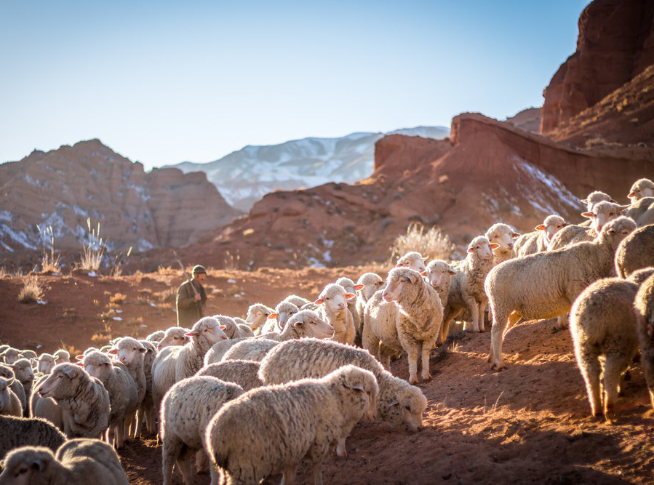
Healthy churches are alert to various attacks on the gospel (1 Tim 4:1-5)
Demonic deception (v. 1)

Slide 11
John 8:44
You are of your father the devil, and your will is to do your father's desires. He was a murderer from the beginning, and does not stand in the truth, because there is no truth in him. When he lies, he speaks out of his own character, for he is a liar and the father of lies.

Slide 12
2 Corinthians 11:13-15
¹³ For such men are false apostles, deceitful workmen, disguising themselves as apostles of Christ. ¹⁴ And no wonder, for even Satan disguises himself as an angel of light. ¹⁵ So it is no surprise if his servants, also, disguise themselves as servants of righteousness. Their end will correspond to their deeds.
We can be “outwitted” (2 Cor 2:11)
He has “schemes” (Eph 6:11)
We can be “bewitched” (Gal 3:1)

Slide 14
Healthy churches are alert to various attacks on the gospel (1 Tim 4:1-5)
Demonic deception (v. 1)
False teachers (v. 2)
“It is a terrible combination of words, since hypocrisy is a deliberate pretence and a lie a deliberate falsehood. So then false teachers, although seduced by deceiving spirits, are themselves intentional deceivers, however misleading their mask of learning and religion may be. They do not themselves believe what they are teaching.”
John Stott

Slide 15
Acts 24:16
So I always take pains to have a clear conscience toward both God and man.

Slide 16
Healthy churches are alert to various attacks on the gospel (1 Tim 4:1-5)
Demonic deception (v. 1)
False teachers (v. 2)
Unbiblical practices (v. 3-4)

Slide 17
2 Timothy 2:16-18
¹⁶ But avoid irreverent babble, for it will lead people into more and more ungodliness, ¹⁷ and their talk will spread like gangrene. Among them are Hymenaeus and Philetus, ¹⁸ who have swerved from the truth, saying that the resurrection has already happened. They are upsetting the faith of some.

Slide 18
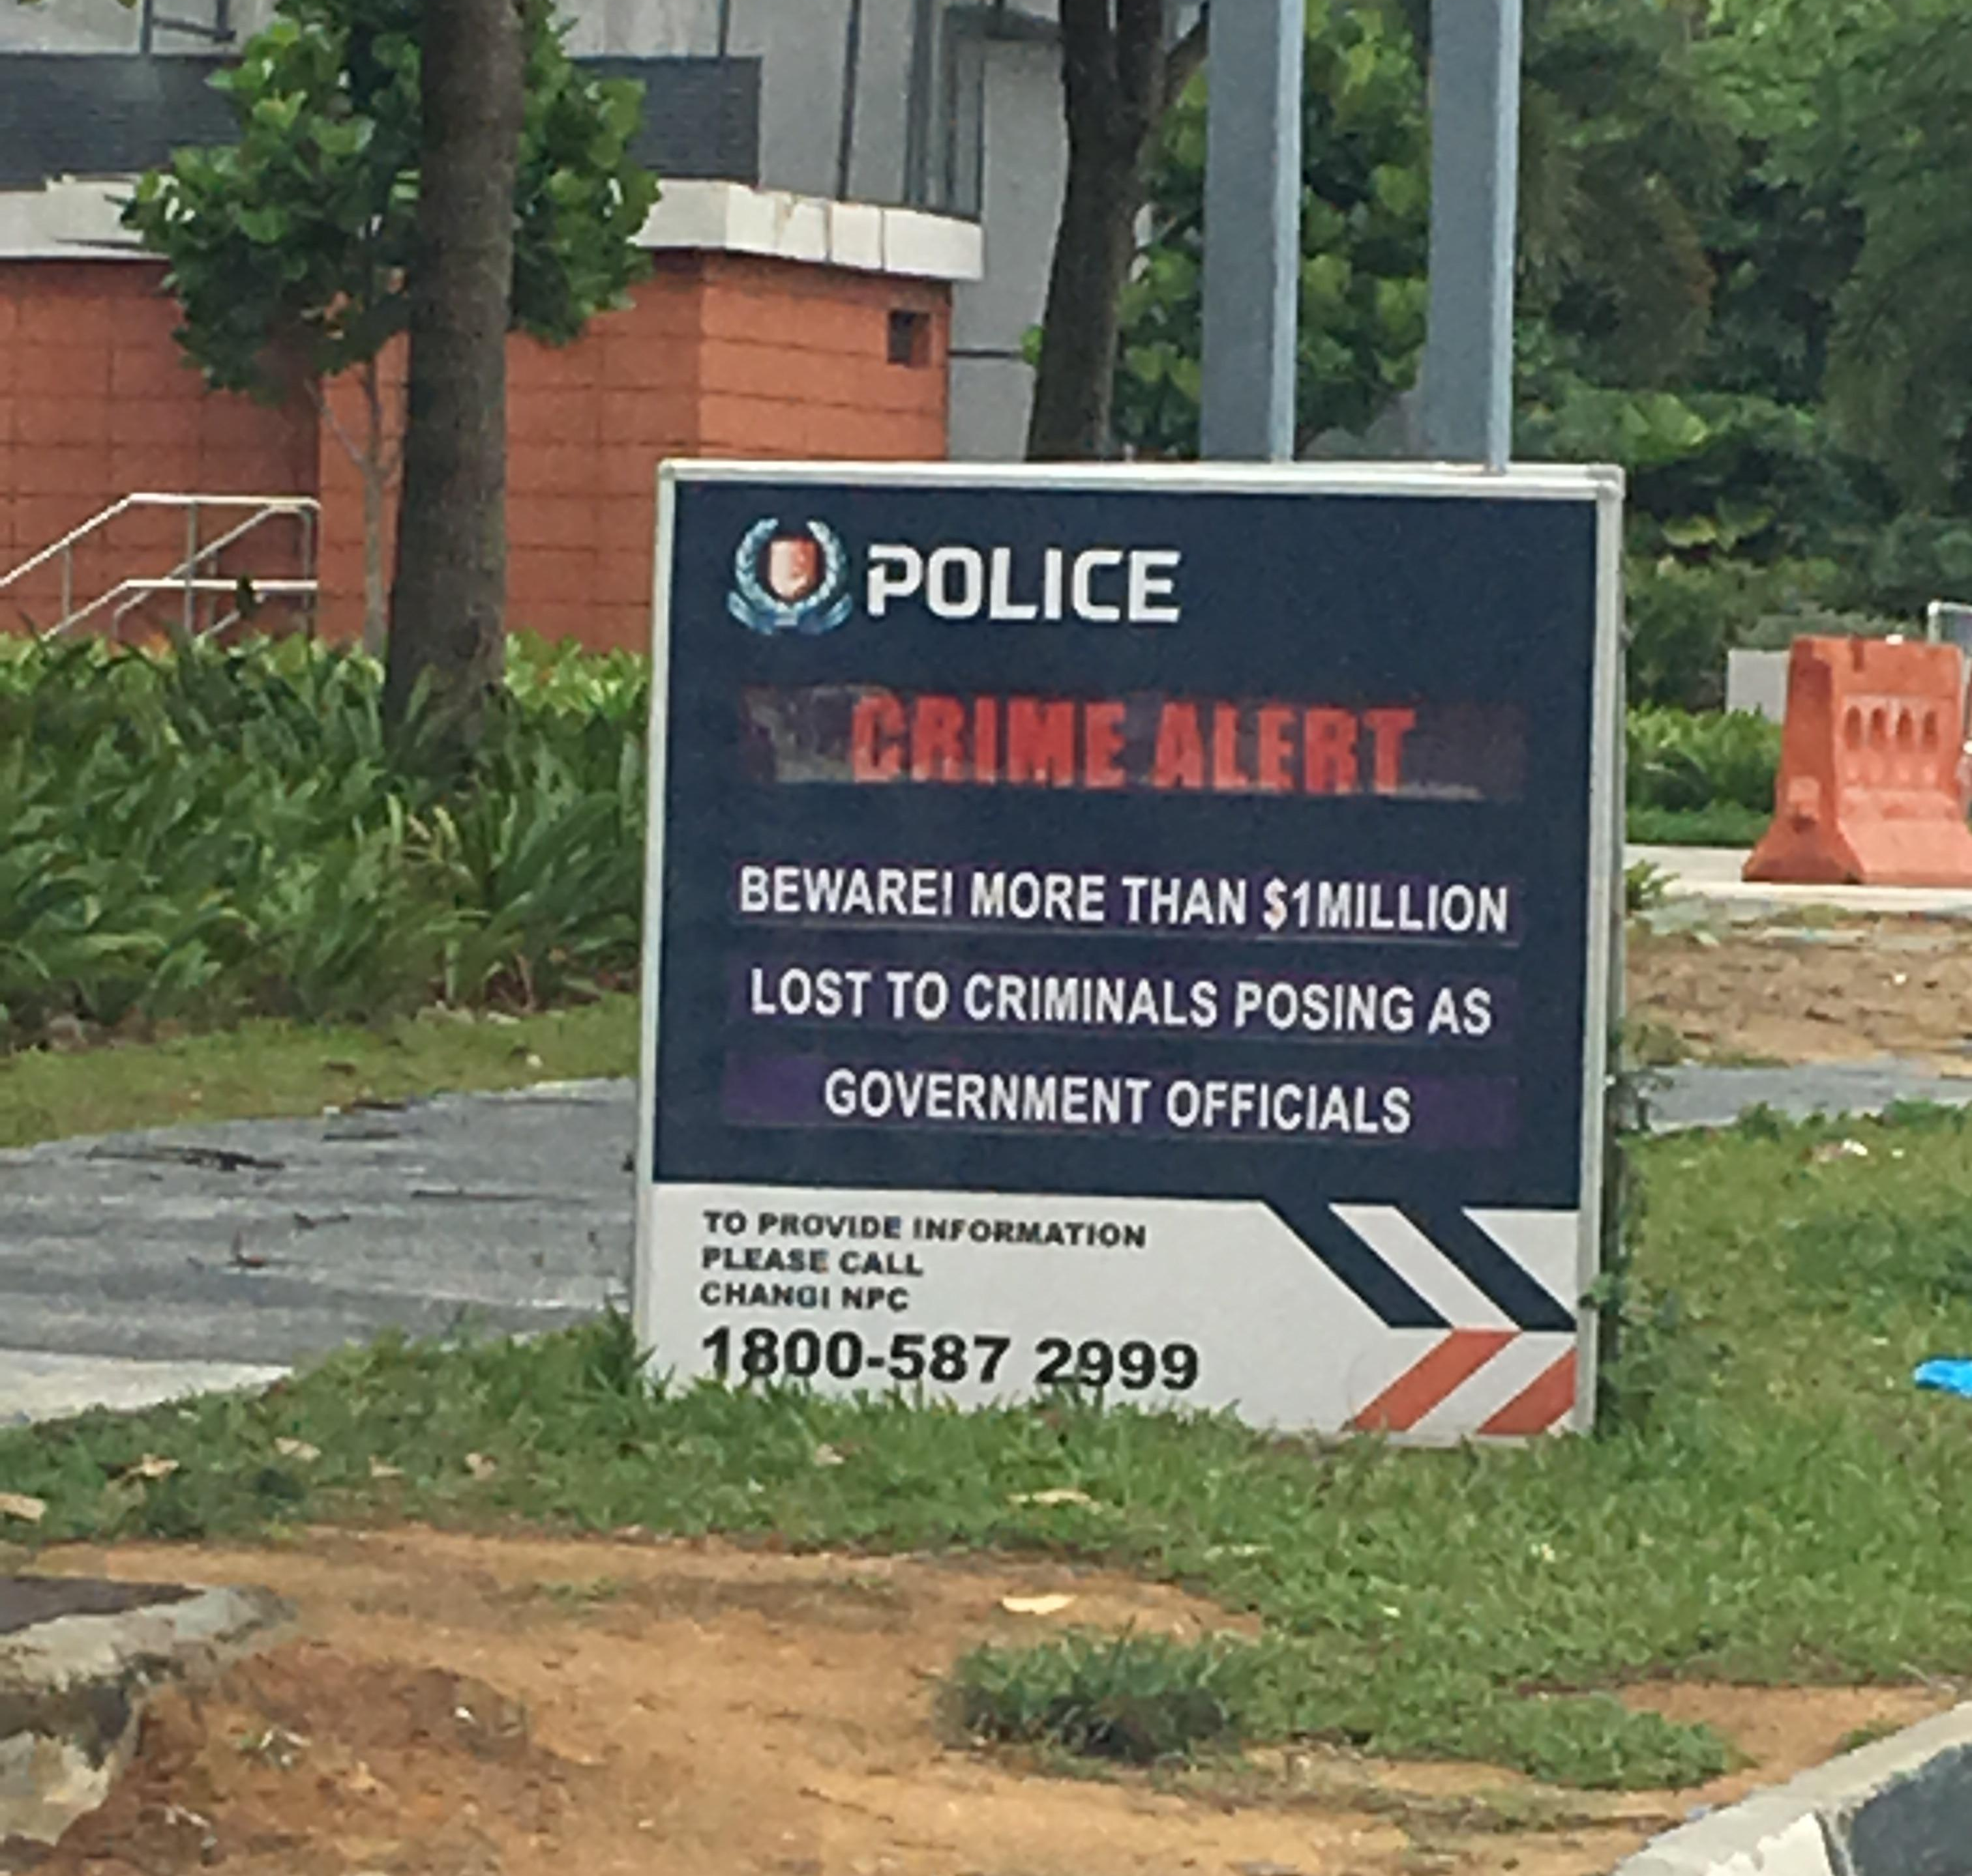

Slide 19
Healthy churches are alert to various attacks on the gospel (1 Tim 4:1-5)
Healthy churches counter the influence of false teaching (1 Tim 4:6-10)
The congregation is alert to false teaching (v. 6)
They are careful not to be gullible (v. 7a)
“silly” also translated
“fit only for old women” (NASB)
“old wives’ fables” (NKJV)
“old wives’ tales” (NLT)

Slide 20
Hebrews 5:11-15
¹¹ About this we have much to say, and it is hard to explain, since you have become dull of hearing. ¹² For though by this time you ought to be teachers, you need someone to teach you again the basic principles of the oracles of God. You need milk, not solid food, ¹³ for everyone who lives on milk is unskilled in the word of righteousness, since he is a child. ¹⁴ But solid food is for the mature, for those who have their powers of discernment trained by constant practice to distinguish good from evil.

Slide 21
Healthy churches are alert to various attacks on the gospel (1 Tim 4:1-5)
Healthy churches counter the influence of false teaching (1 Tim 4:6-10)
The congregation is alert to false teaching (v. 6)
They are careful not to be gullible (v. 7a)
They pursue godliness (vs. 7b-10)

Slide 24
NT Preaching • BibleStudyDownloads.org
Get this presentation for free!

